Slide 1
point of sale web application
Presented by :
Noor Rashid​

Slide 2
AGENDA
Summary
Introduction​
Outline
Goals(pages )
​Secured
​Conclusion

Slide 3
summary
Building POS Web Application:
I designed Front End Web page using HTML, CSS which was implemented in Login Page.
I used Front End Frame work and libraries through using bootstrap and jQuery which are implemented in all POS web application.
I created API to handle AJAX requests, where it is implemented in SELLING Dashboard, Transaction Management and User Transaction.
I created secured web apps be, no SQL injection attacks, no easy-to-read passwords, and no XSS vulnerabilities.
I created web apps based on MVC design pattern that is implemented in all details within POS web application.
I created roles of employees through determine in form (create, update users) and hard coded , where the app is controlled based on permissions.
Notes:
Building POS Web Application:
I designed Front End Web page using HTML, CSS which was implemented in Login Page.
I used Front End Frame work and libraries through using bootstrap and jQuery which are implemented in all POS web application.
I created API to handle AJAX requests, where it is implemented in SELLING Dashboard, Transaction Management and User Transaction Pages. C
I created secured web apps based on MVC design pattern that is implemented in all details within POS web application.
I created roles of employees through hard coded (create, update users) where the app is controlled based on permissions.

Slide 4
We will Improve POS Web Application using PHP MVC framework.
Technology used:
Database connection SQL query
Session
Cookies
Better page controller that accept different page parameters, or any other feature can be added very easily, and this report (presentation) shows the way to build a really simple POS Web Application through PHP MVC.

Slide 5
Requirement: To build a point of sale (POS) web application implemented & enhanced by Mvc & specified to handle the store (sales ,transaction & stock), and employees with different role in POS.

Slide 6
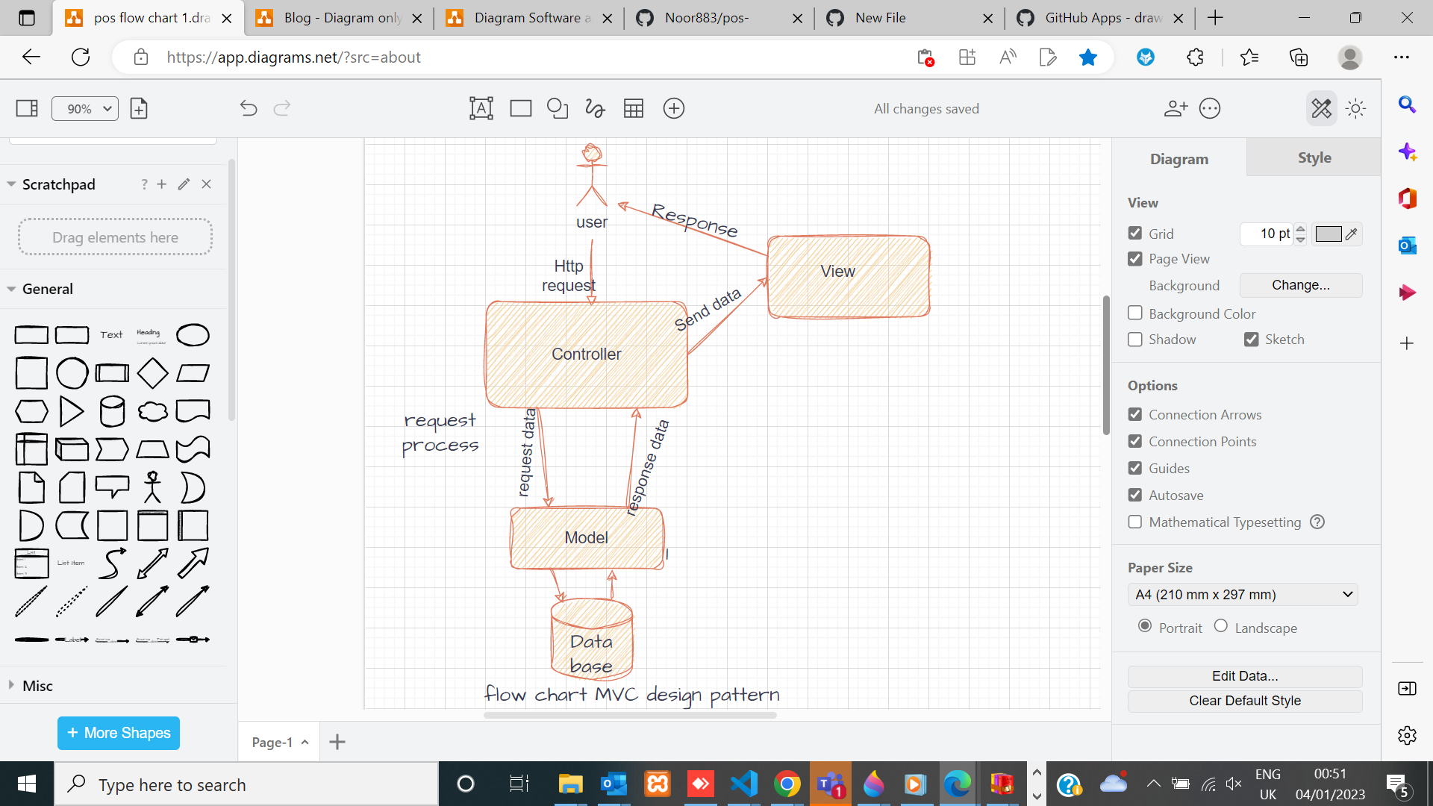
Flow chart of mvc & implementation of pos
 | MVC
 | M: Model
 | V: View
 | C: Controller

Slide 7
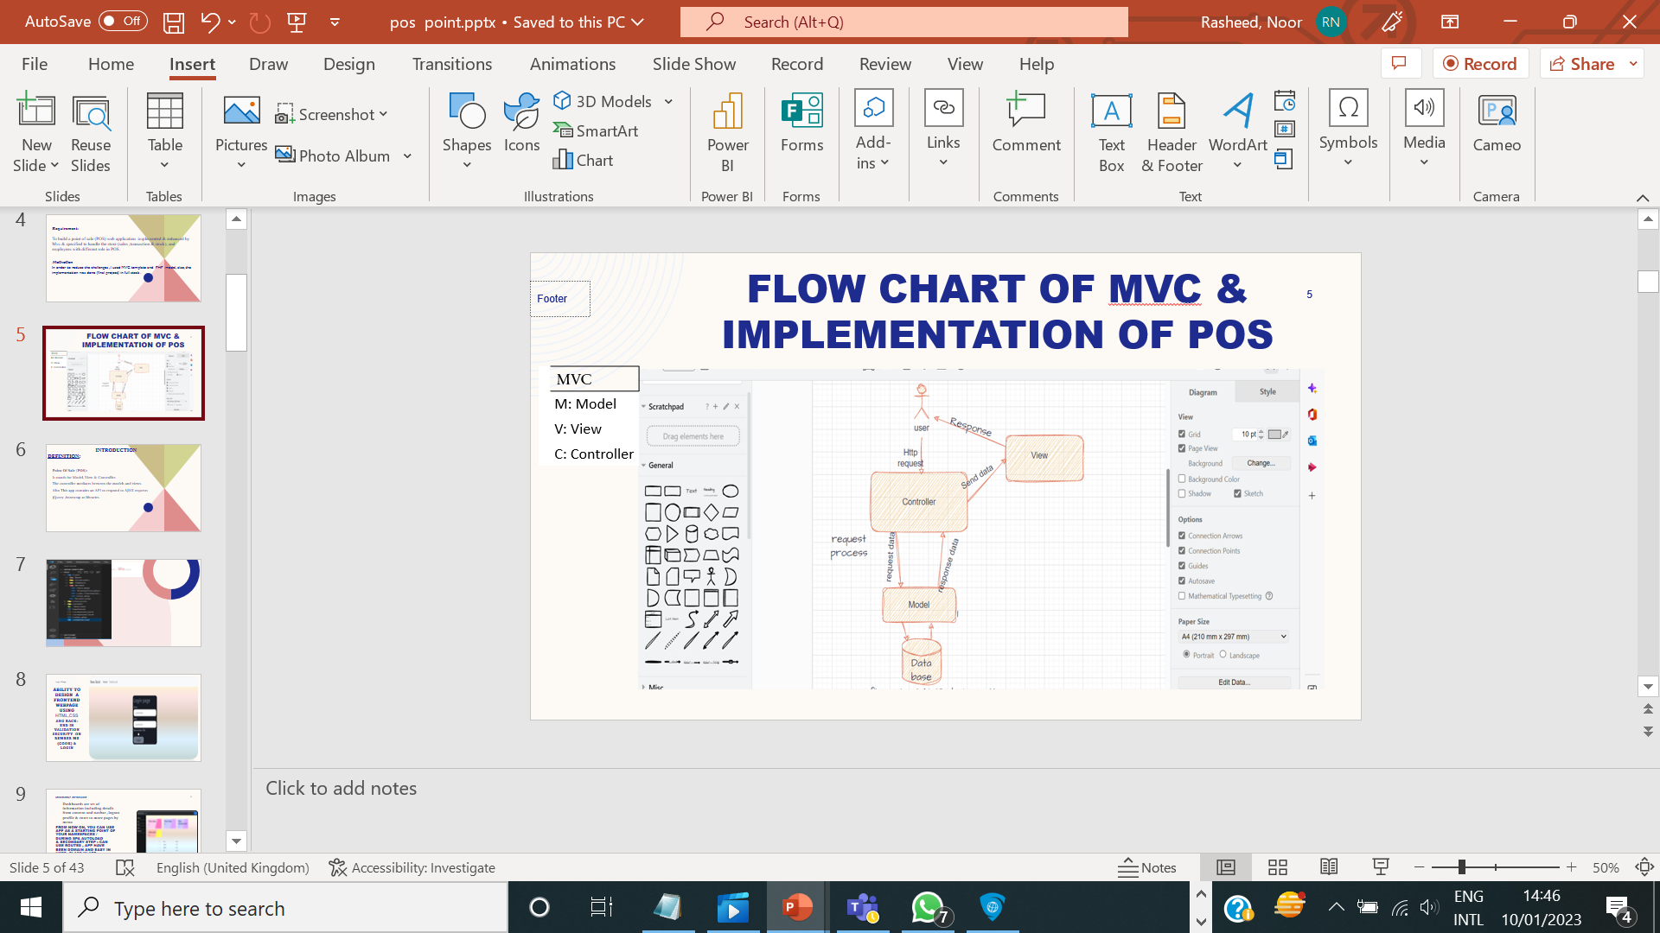
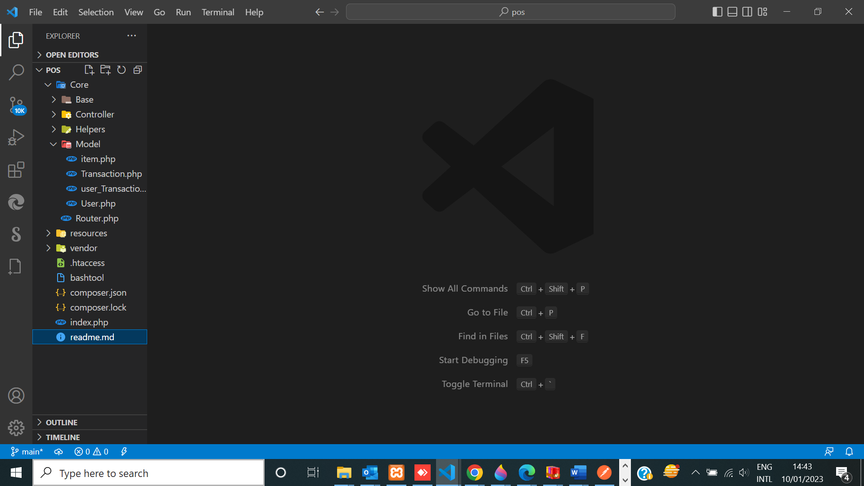
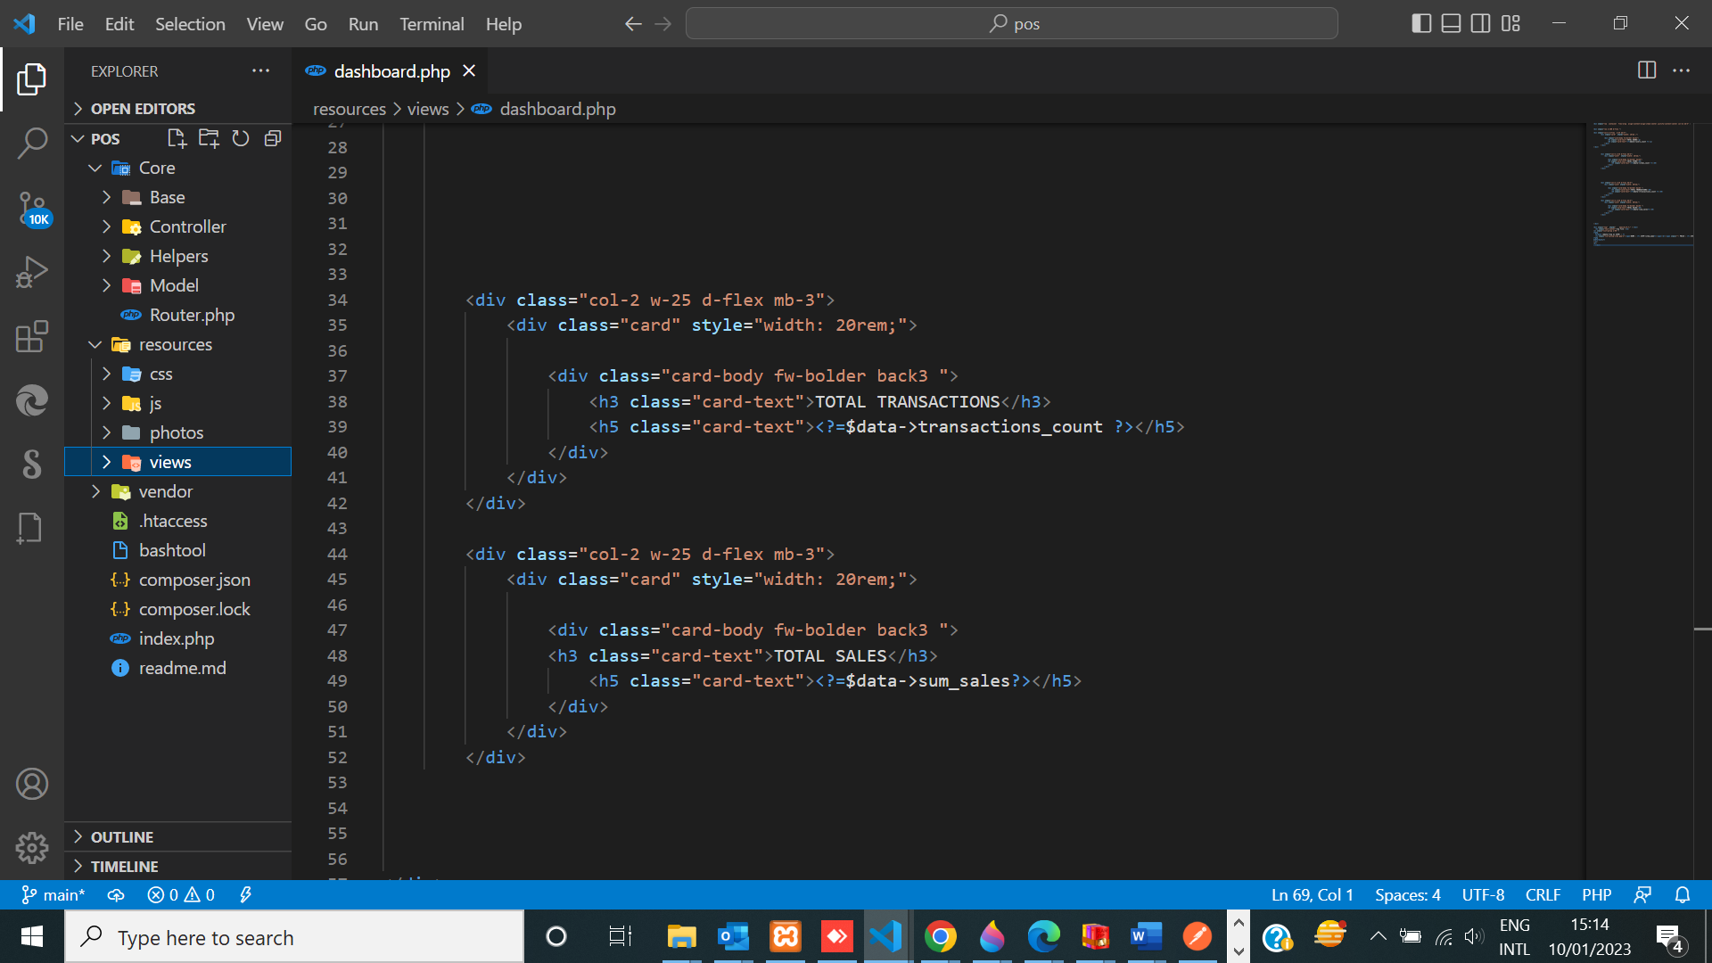
web application should be build using MVC design pattern.

Slide 8
Introduction Definition:
Point Of Sale (POS):
It stands for Model, View & Controller.
The controller mediates between the models and views.
Also This app contains an API to respond to AJAX requests
jQuery ,bootstrap as libraries.

Slide 9
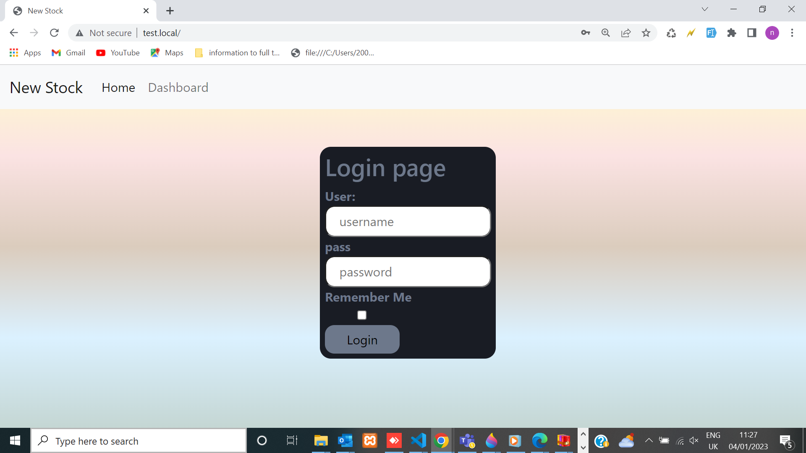
ability to design a frontend webpage using HTML,CSS and back-end in validation security on rember me (cookie) & loG

Slide 10
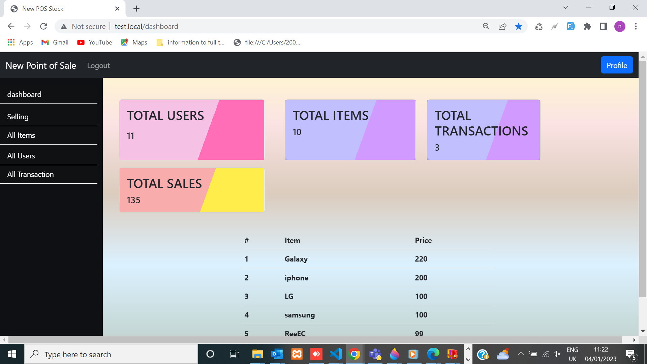
Dashboards are set of information including details from content and navbar , logout profile & enter to more pages
by menu

Slide 11
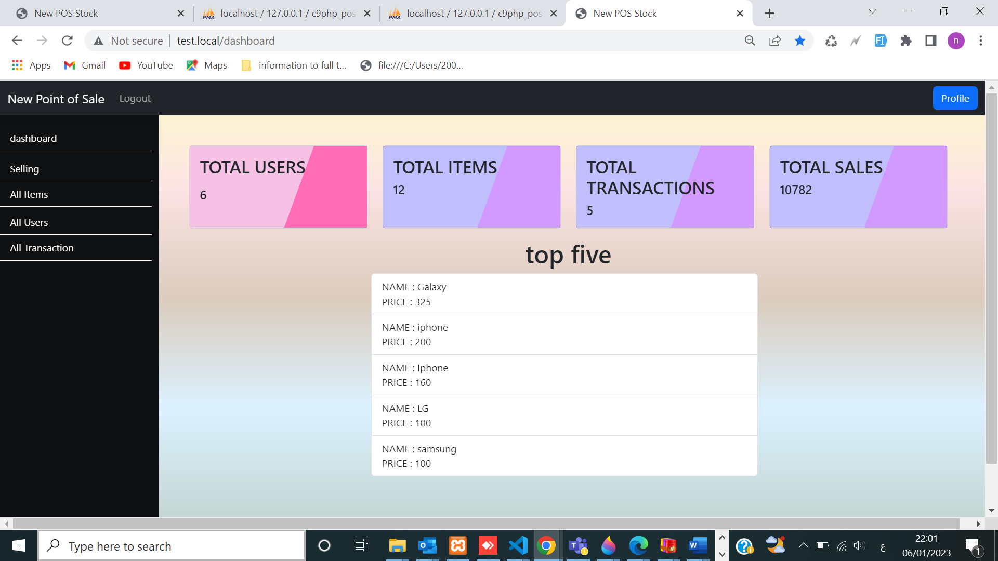
APP dashboard contains :
screen dashboard &menu 1.total items. 2.total users. 3.total transactions. 4.total sales. 5. Top five expensive items to buy
6. Menu .
7.Profile &
implementation during point of sales website App.

Slide 12
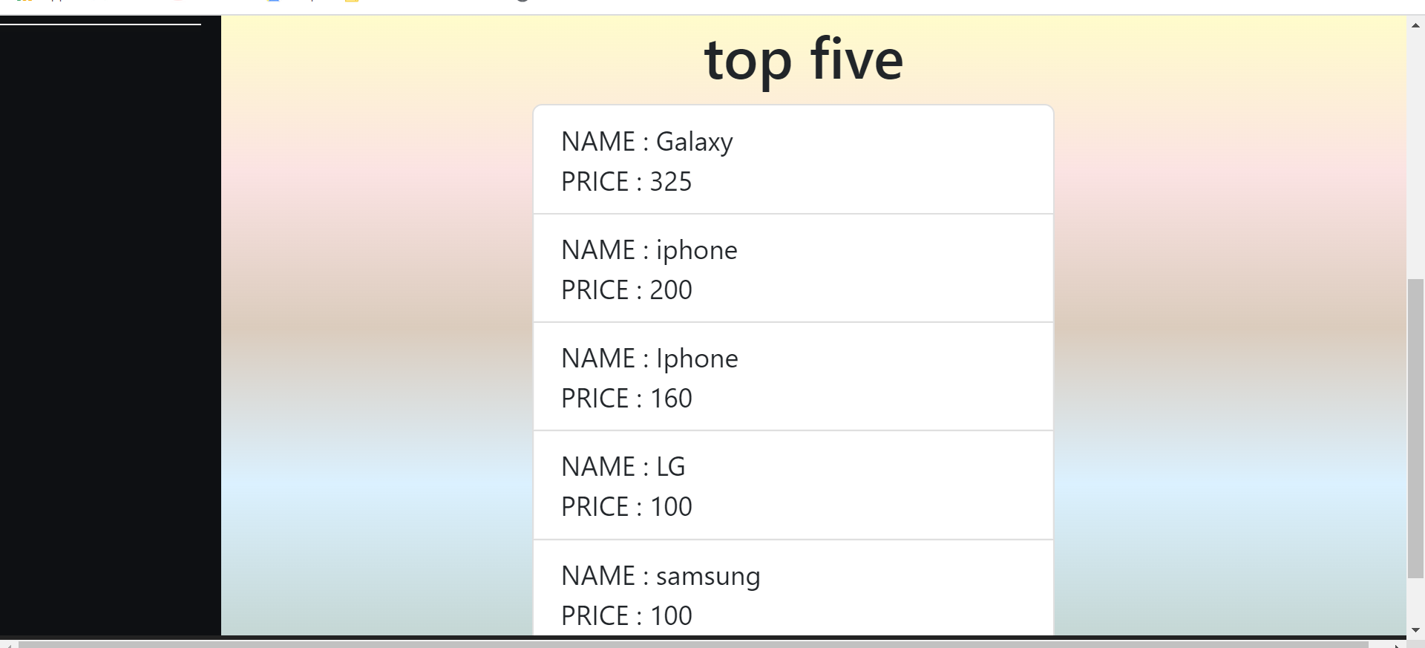
Top five expensive items to buy

Slide 13
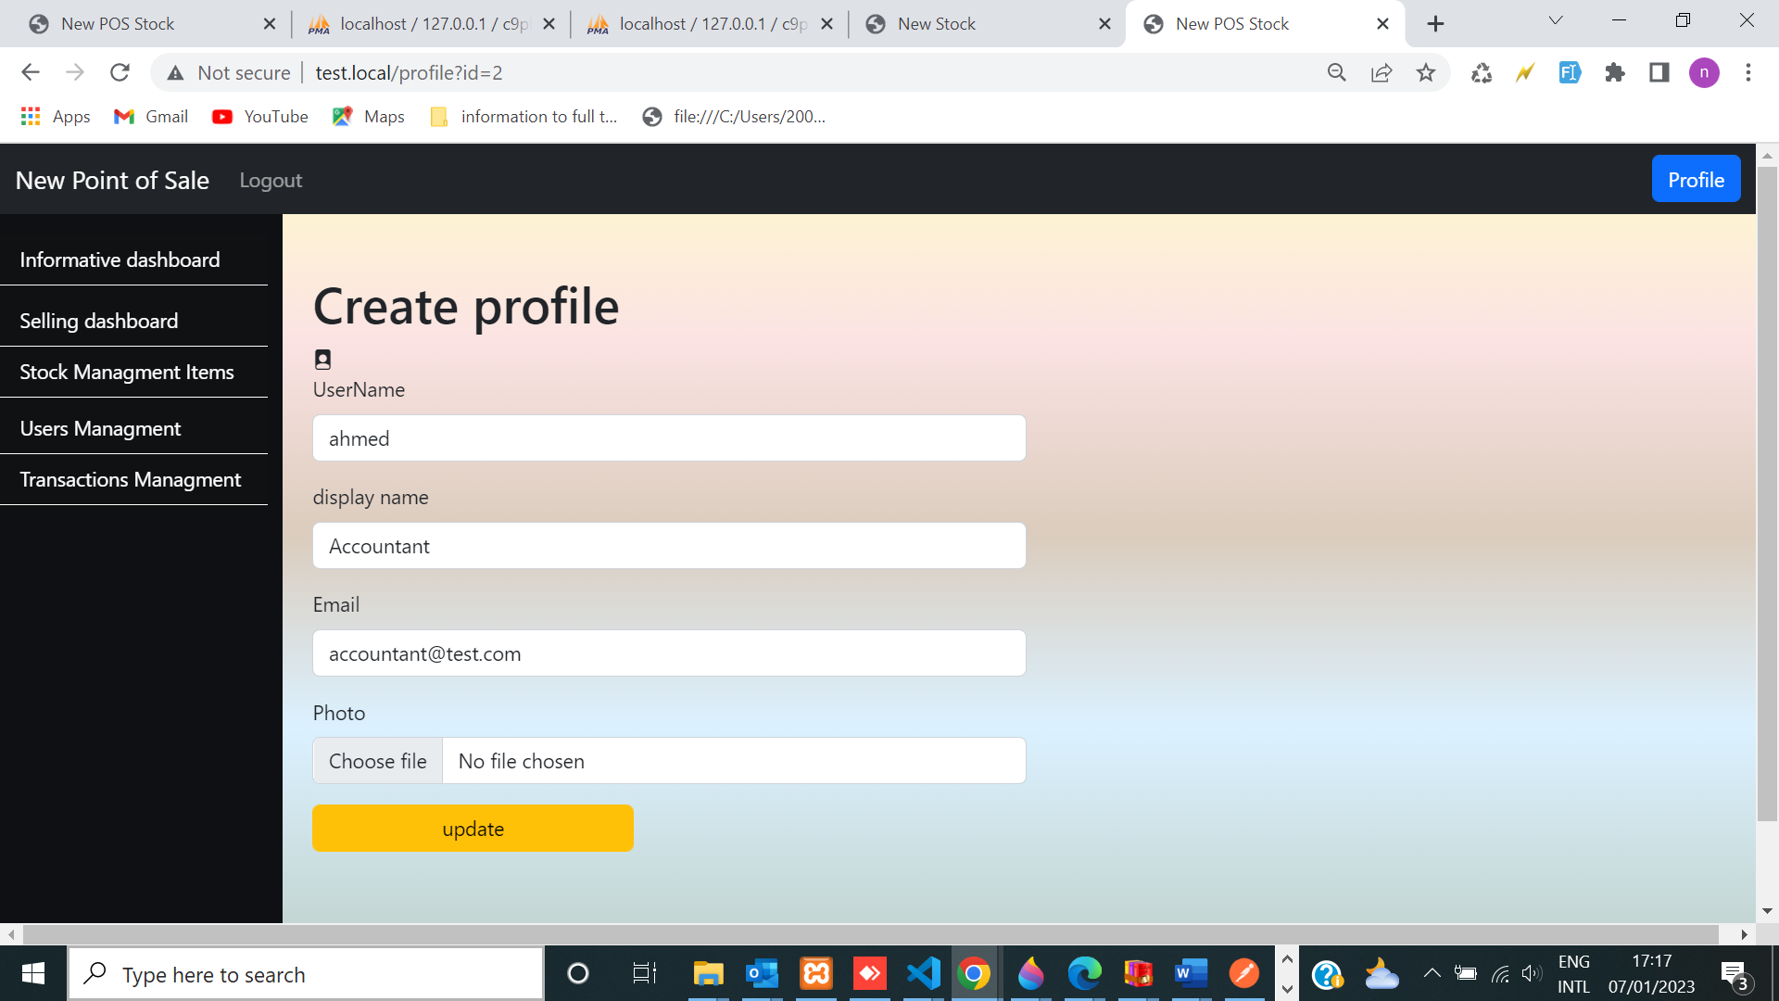
each user that has picture and the user is able to update their information username, email, and display name and update photo.
.

Slide 14
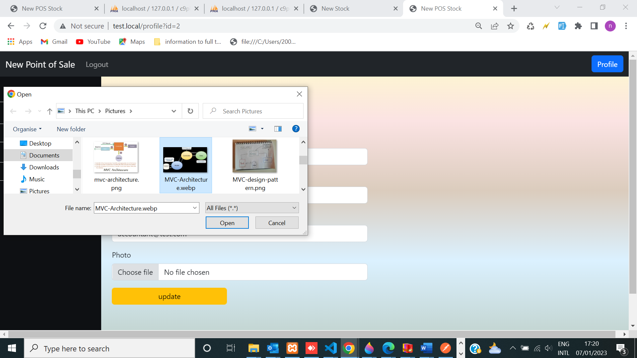

Slide 15
Operations Occurred in Database (create, read, update and delete). will interact with the database
Create
Read
Update
delete
GET METHODS &
Set methods
Public function create (array $data) { }
public function index (int $id) { }
public function update (int $id, array $data) { }
public function delete (int $id) { }
get_by_id { return $this->id;

Slide 16
We can display below pages within POS web application
Informative dashboard as (home ),
Selling dashboard page
Users page
Transaction management
Items page
Log page
Profile page

Slide 17
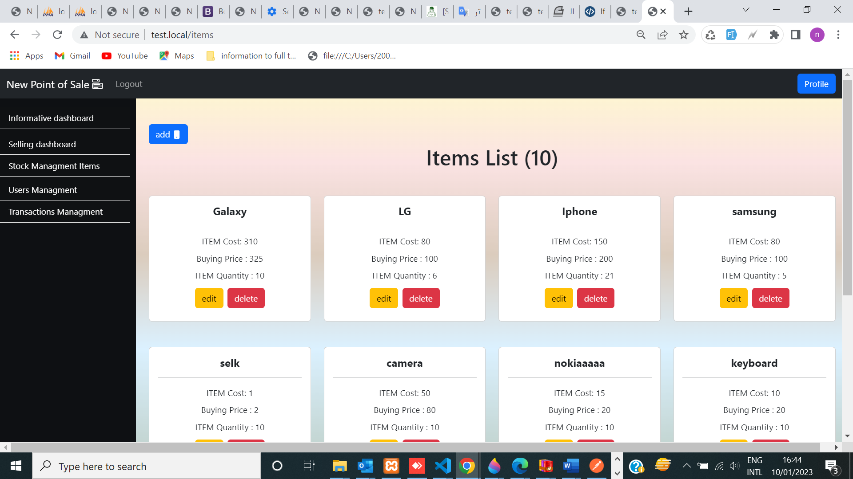
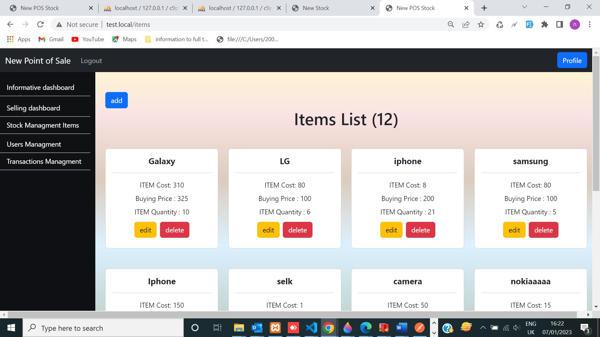
all Items list in stock management page

Slide 18
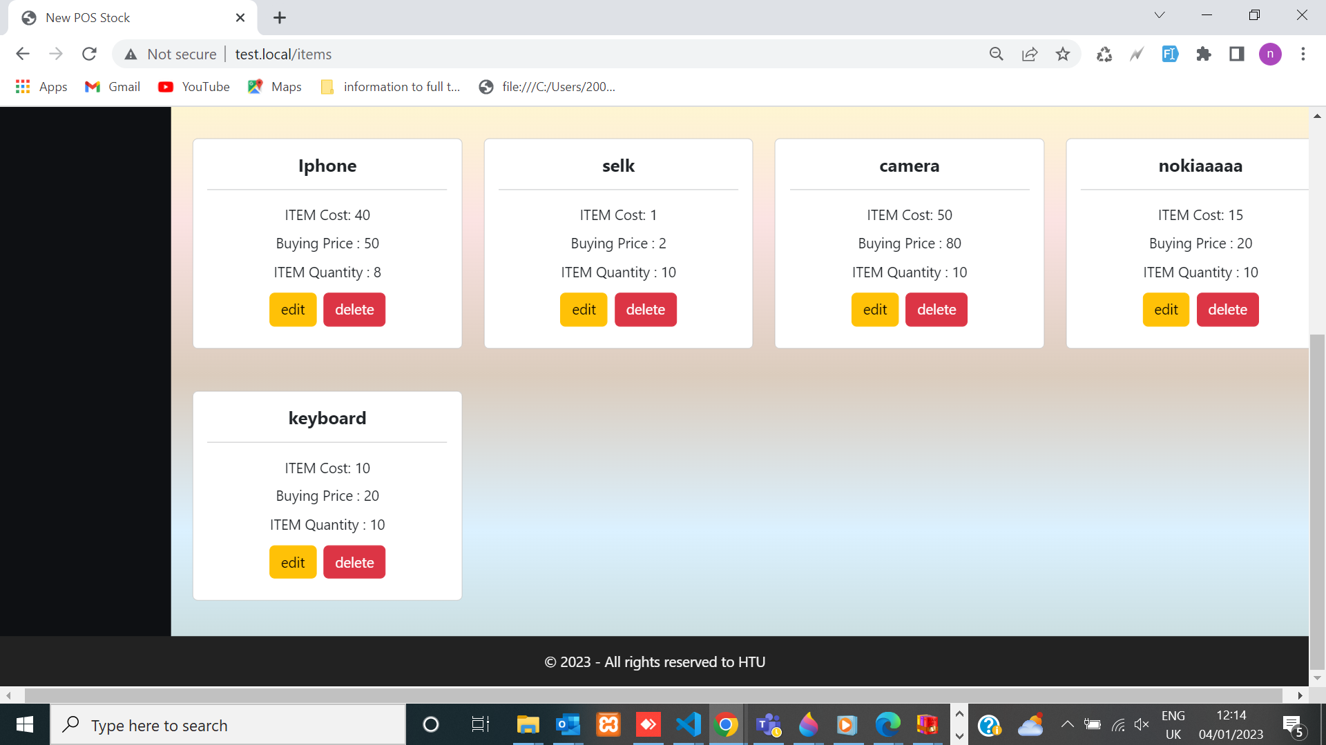
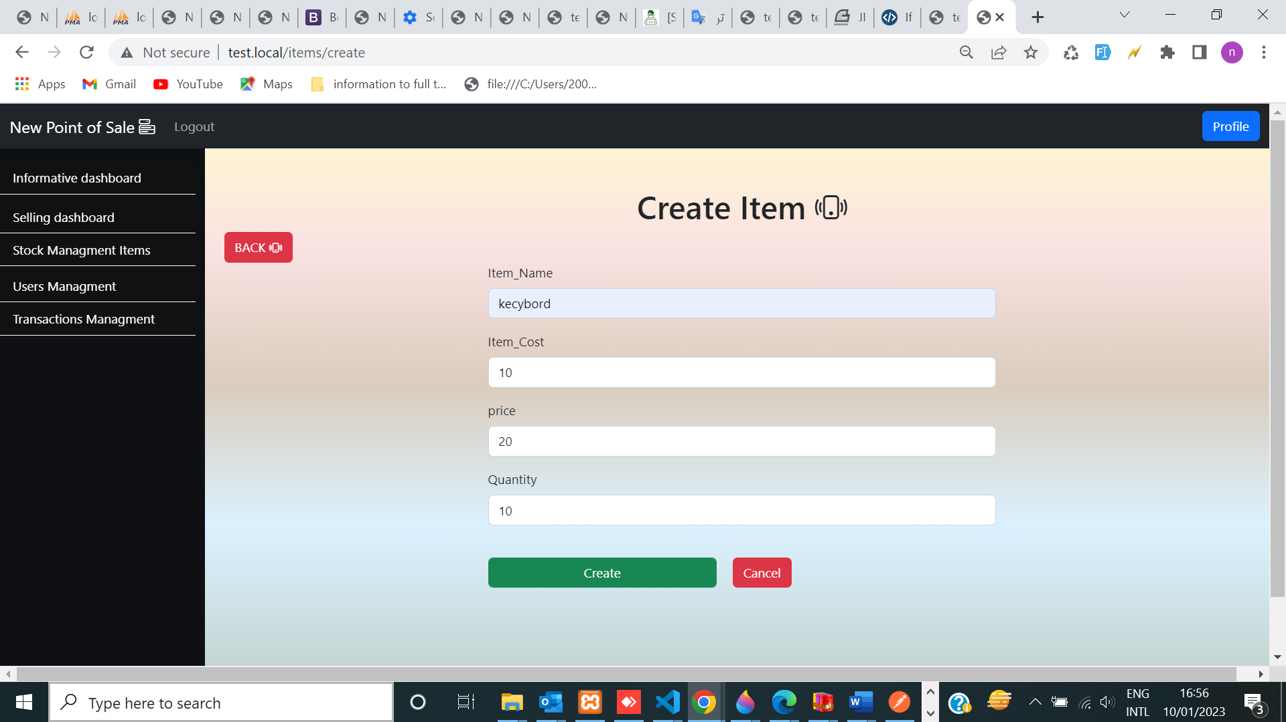
Create item in stock management page

Slide 19
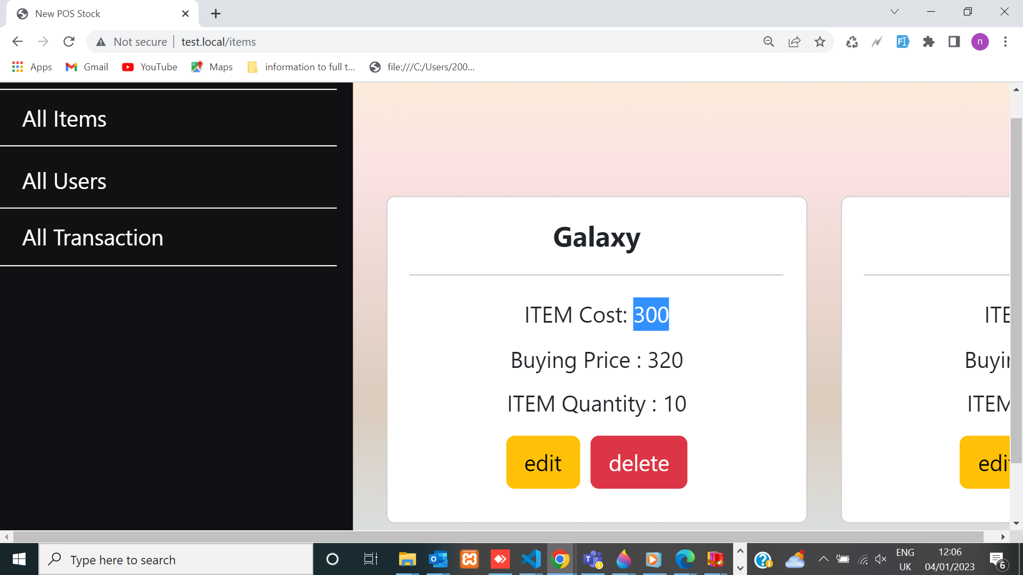
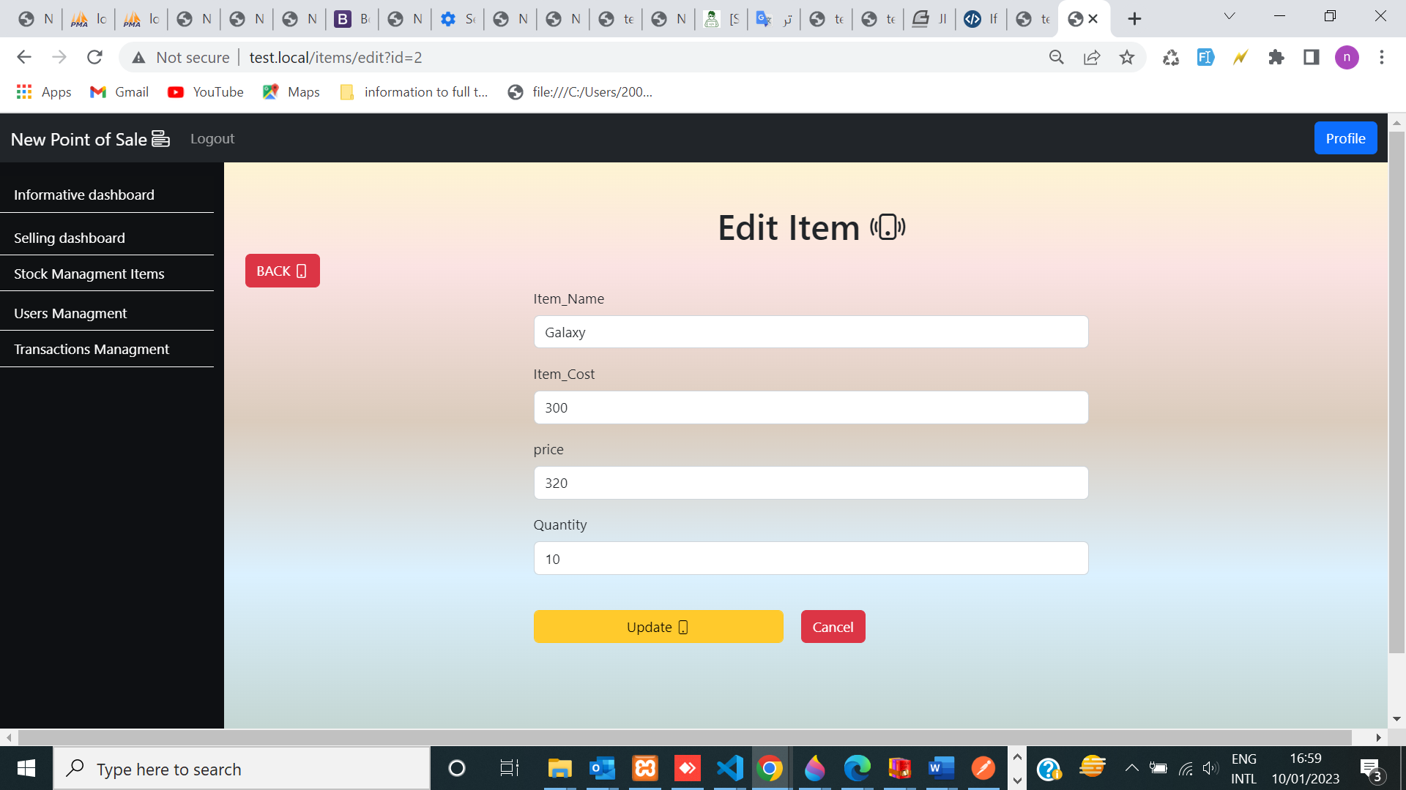
When Clicking on edit item, and updating the details, then the item details will be changed

Slide 20
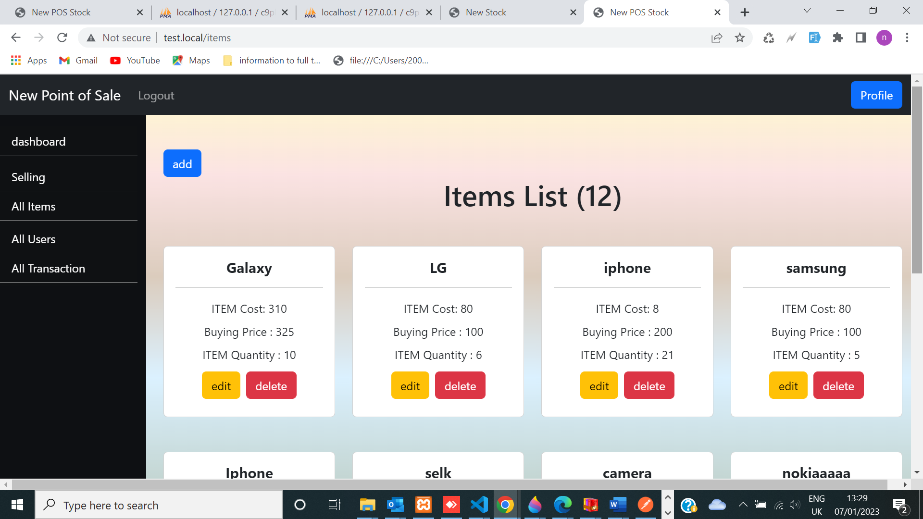
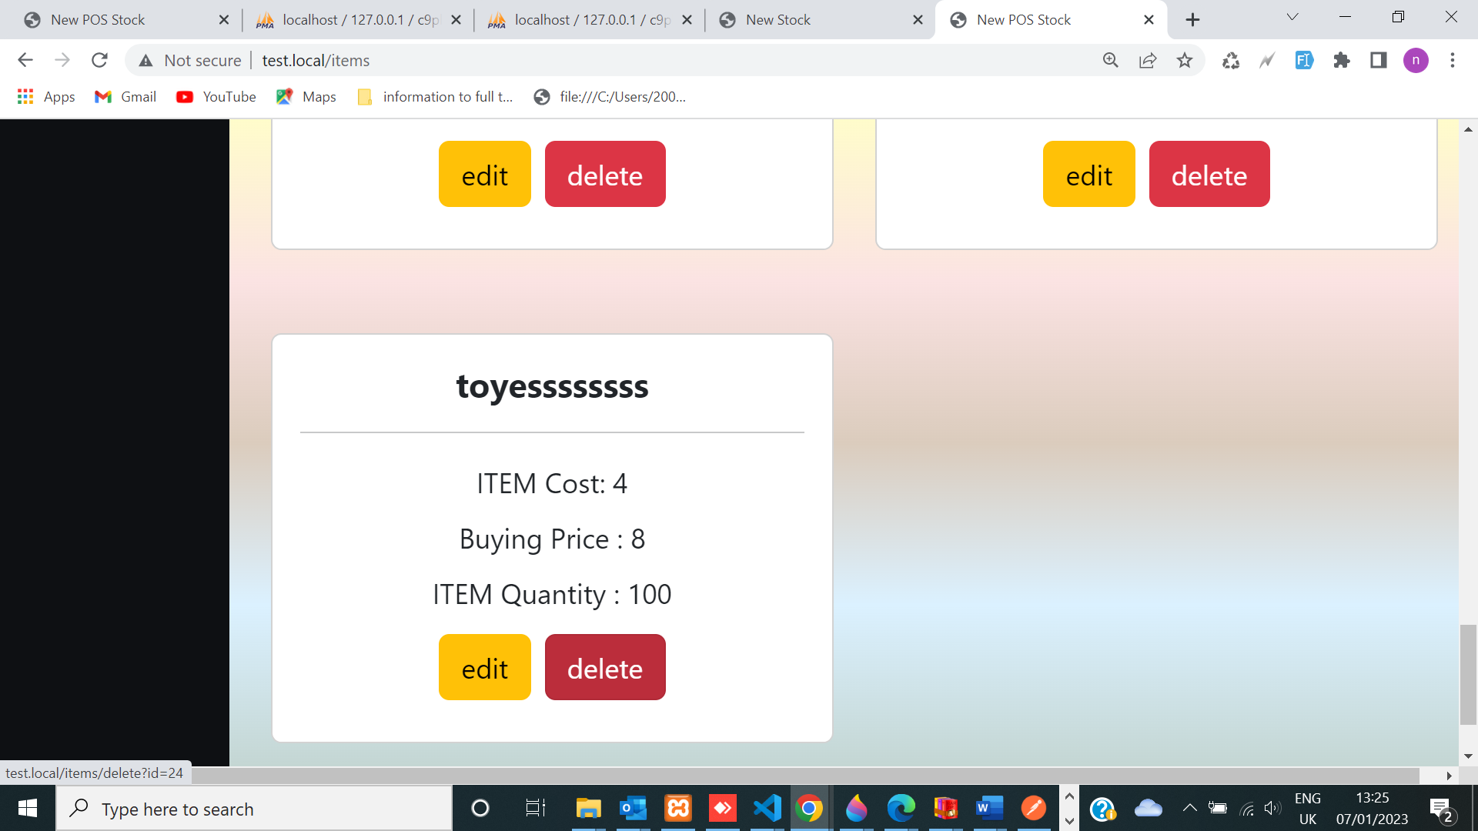
Delete item

Slide 21
USERS PAGE with crud operation
This page is implemented into fronted and back_end in App POS
I determined roles to all user as admin, seller, procurement or accountant.
The Web App is connected with database by controller which interacts with model and the view is displaying through HTML template.

Slide 22
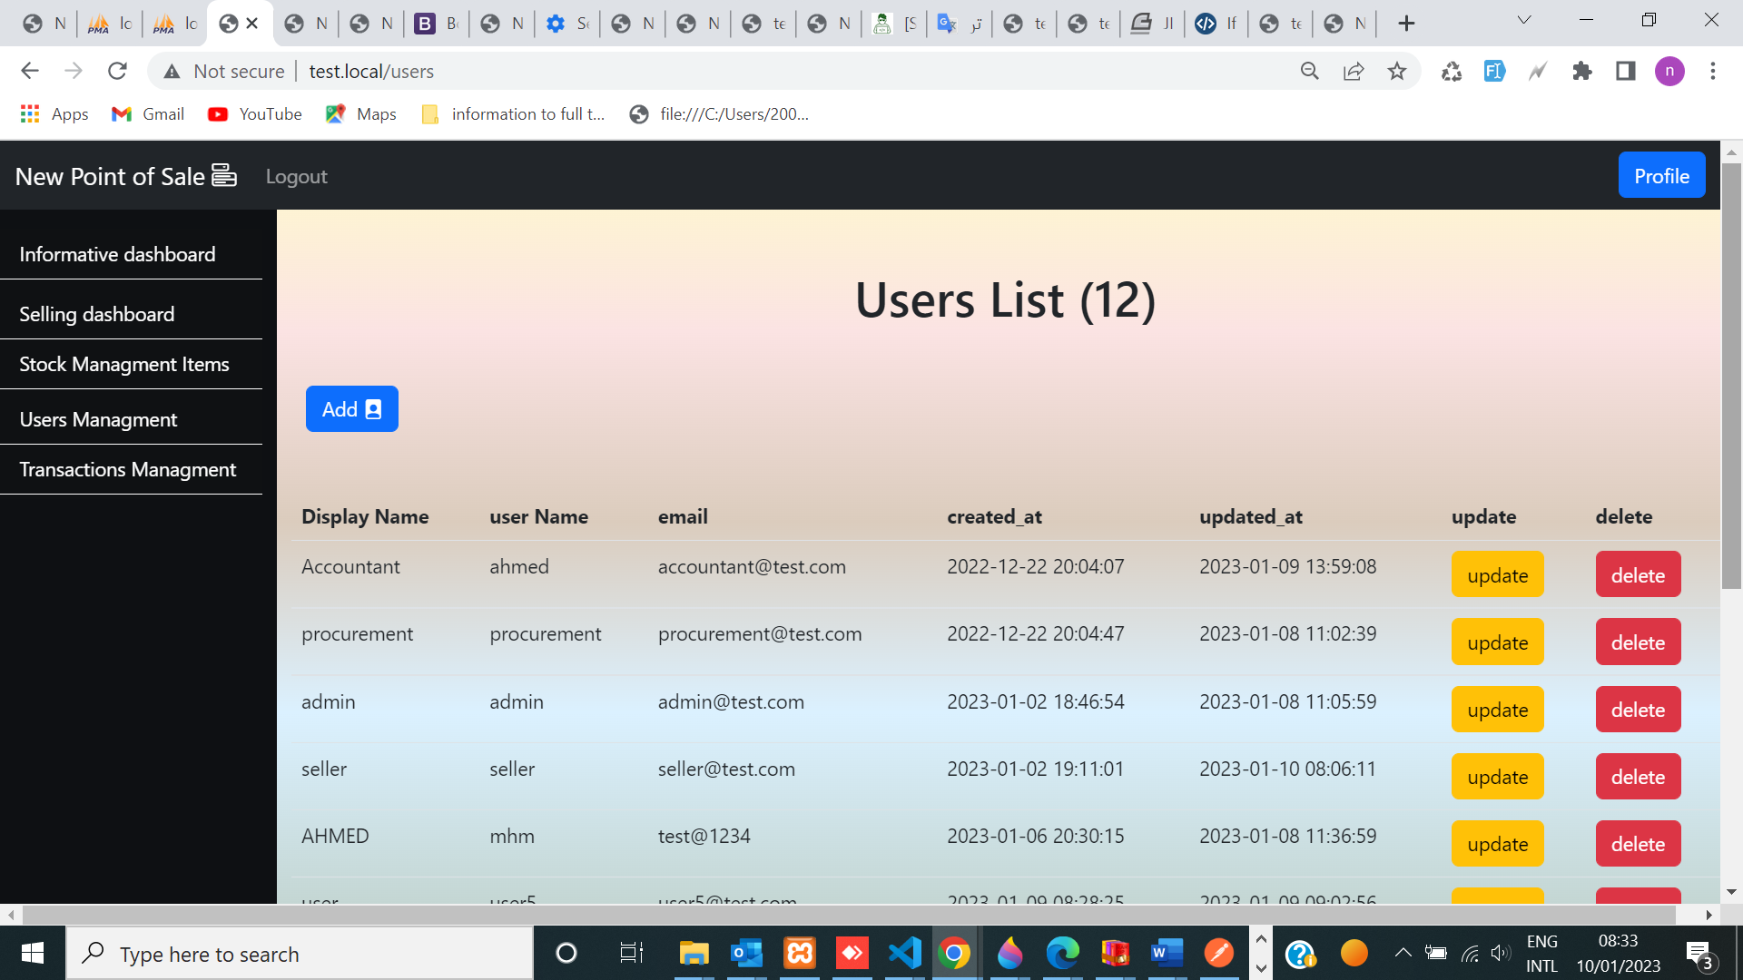
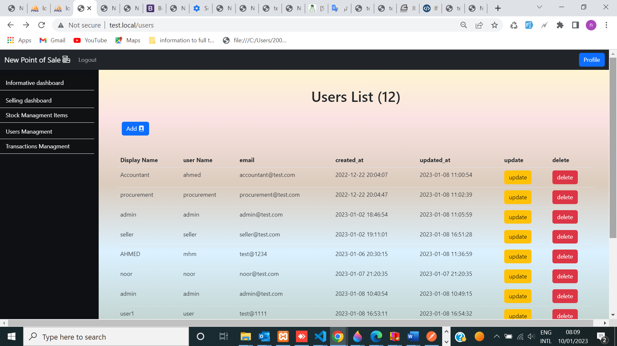
Implement crud operation (READ Create with action as add)

Slide 23
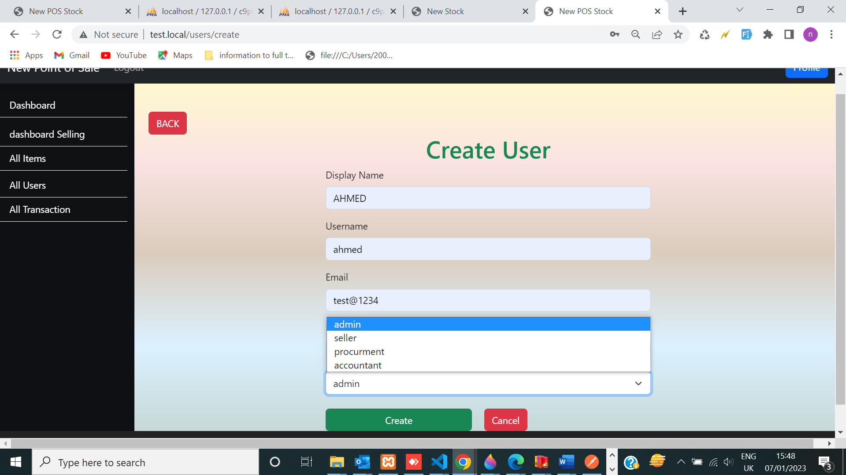
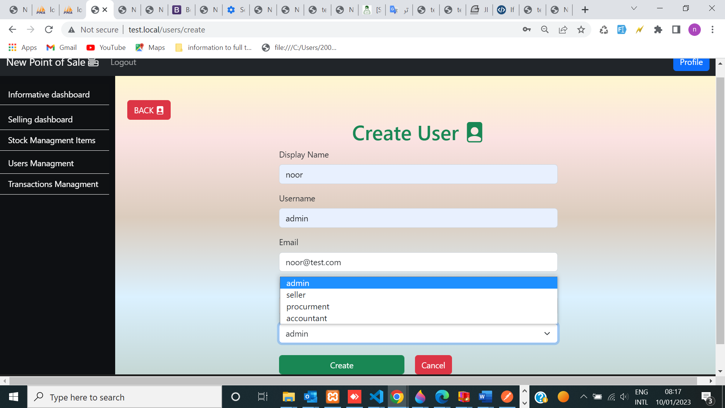
We can create user & determine permission through admin and grant better security in APP

Slide 24
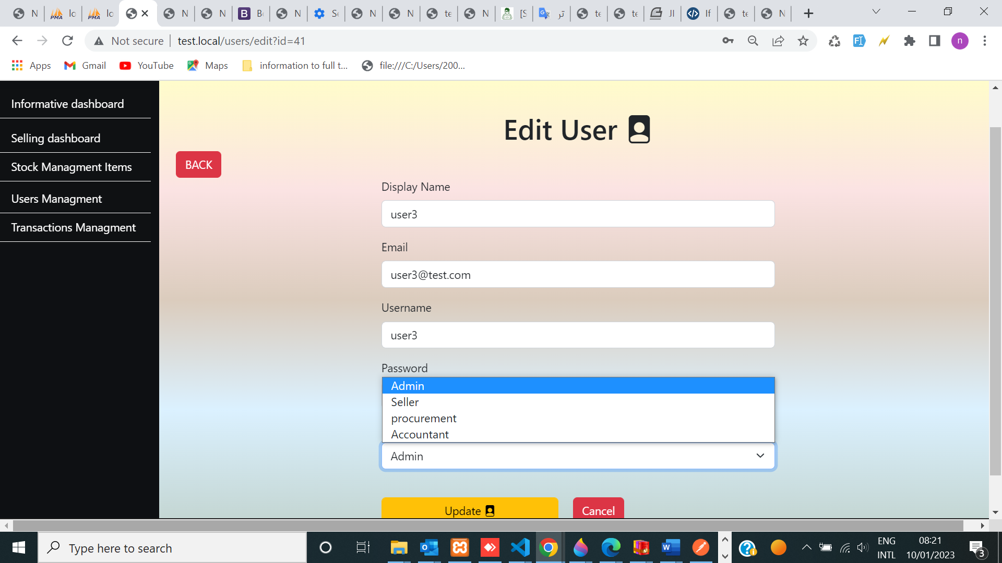
implementation Crud operation update on user
I can
Edit(Update) user
&
determine permission through admin and grant better security in APP

Slide 25
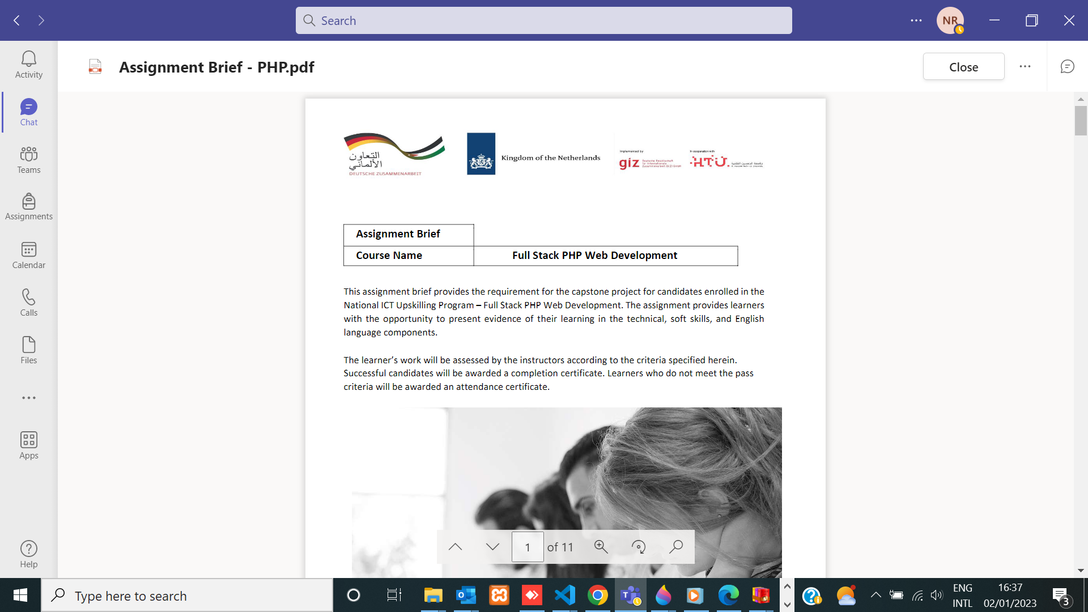
BUSINESS OPPORTUNITIES ARE LIKE BUSES. THERE'S ALWAYS ANOTHER ONE COMING.
proverb
“
”
Richard Branson

Slide 26
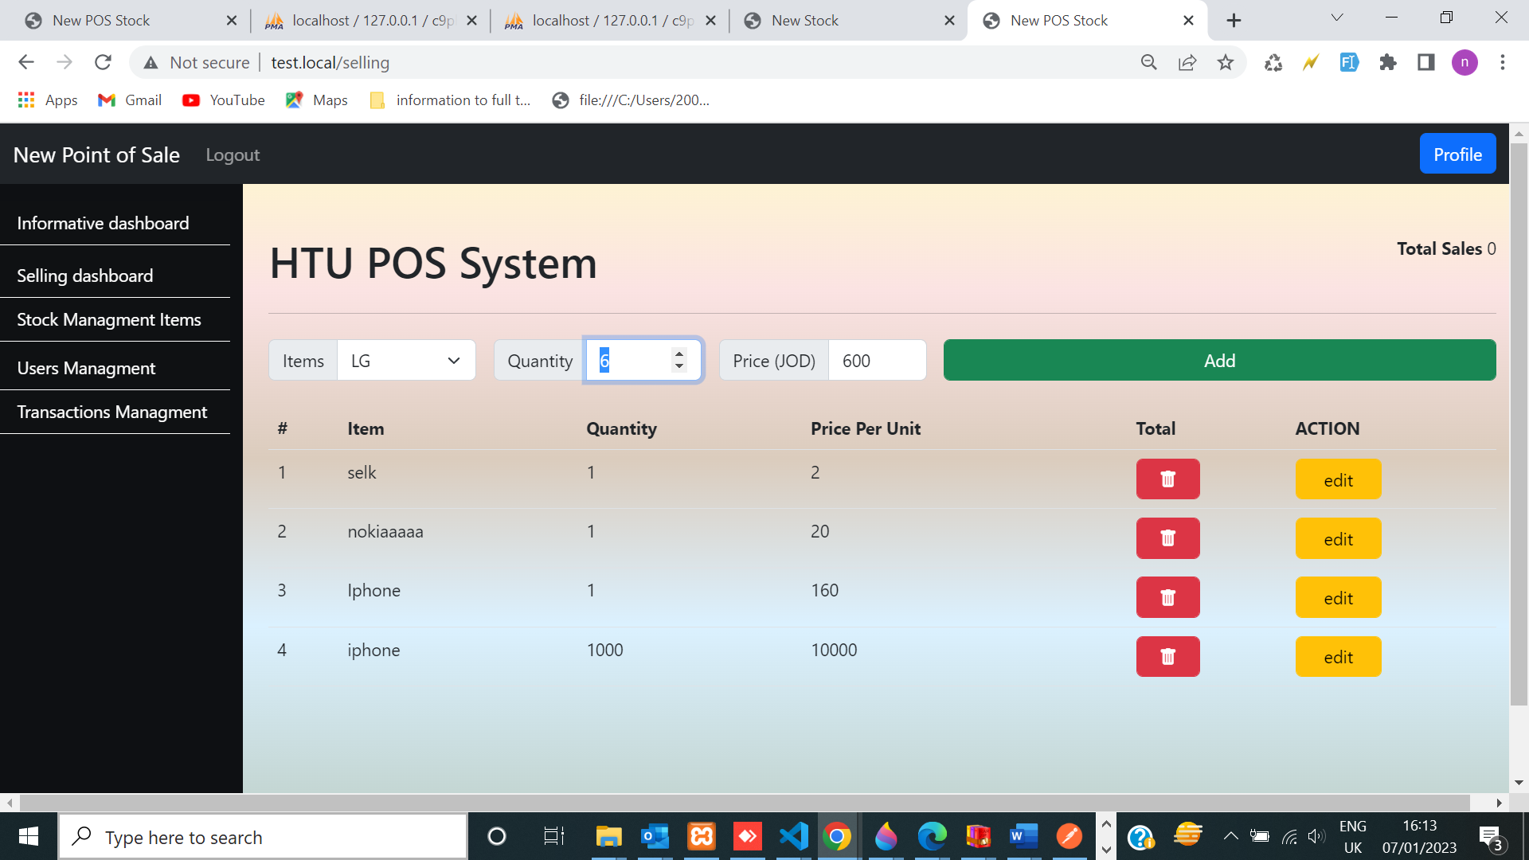
Htu Pos System by api
Implementation using: API, JSON, JS and jquery ,api ajax as front_end and back_end
and it is connected with transaction & saved in
data base
Using routes & name space

Slide 27
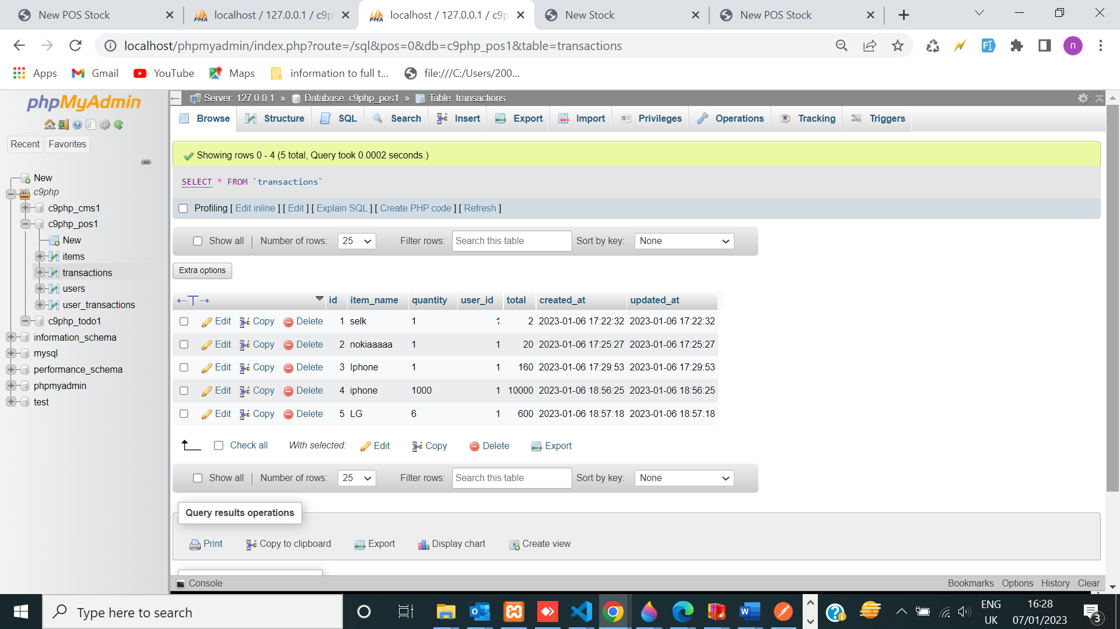
Saving Selling dashboard in data base
Containt and used ajax and jquery API

Slide 28
The item and quantity are retrieved from database, -The seller can’t sell items that is out of stock quantity.
Ex : lG quantity = 6 , and if the quantity is higher than 6, then it will not be calculated because It is not existed in the stock. List of transactions that are created on the page by user will be saved in database, also, it will be displayed in transaction management page.

Slide 29
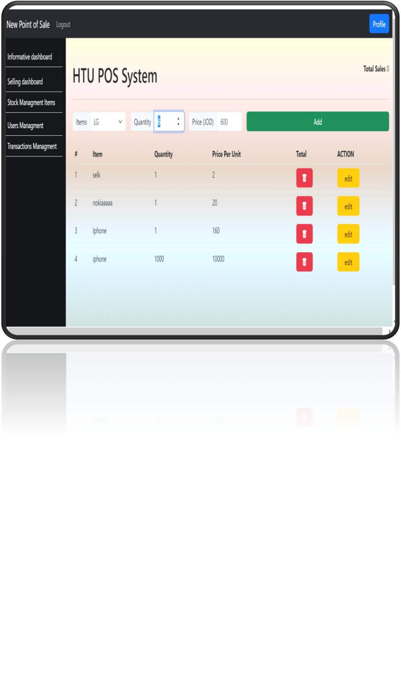
Selling dashboard:
Implementation
The Total Sales will display the total amount price for quantity of every item.
Based on above info. the admin of POS system can see a quick information of the total sales on top of the page.
This dashboard contains selling form with following components (Item name , item quantity ,price per unit ,Total Sales).
When clicking on Add event, transaction list will be created.
The total price is calculated by multiplying item’s quantity with it’s price.

Slide 30
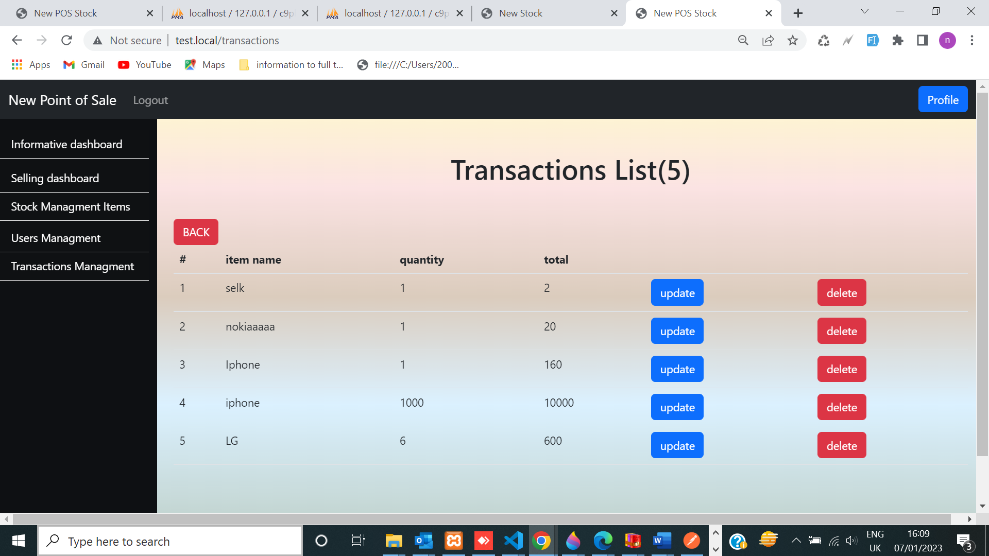
Transaction page will be created from Selling Dashboard
There should be a list in the same page for all the transactions saved in transaction management page and in data base . With update & delete in one transaction & saved in data base and we can edit or delete each transaction on this list directly using action buttons.

Slide 31
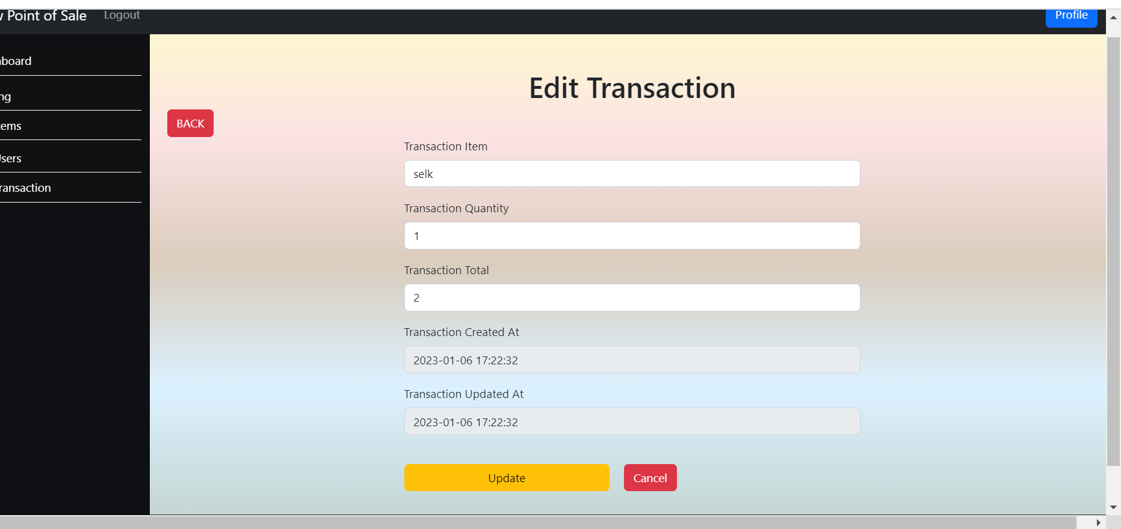
Update on transaction

Slide 32
CRUD OPERATIONS (template , php )
create :
Display the creation form (HTML)
list of items (HTML)as index
Display the edit form (HTML)
delete
api
Called store (PHP)
Creates the items (PHP)
Displays single itemt (HTML)
Updates the items (PHP)
Delete
the item (PHP)
api
)
Disseminate standardized metrics
Coordinate e- business applications
Foster holistically superior methodologies
Deploy strategic networks with compelling e- business needs

Slide 33
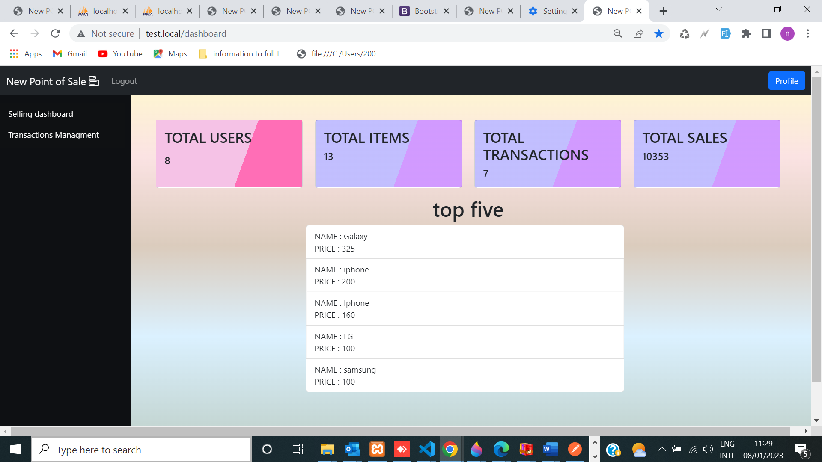
implementing User permission for role as 2 page display on web application
Representing permission with passworded hash Algorithm to encrypt the password
Notes:
Use algorithm hash password , notice figure representation on selling

Slide 34
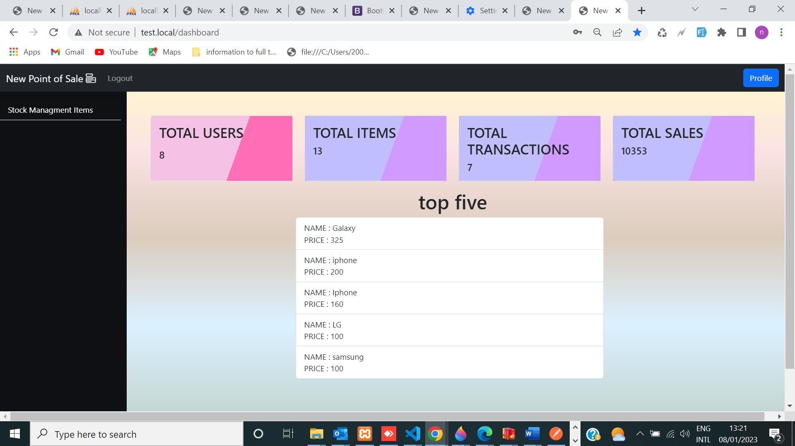
Implementing user permission for stock management page (accountable )
Representing permission with passworded hash Algorithm to encrypt the password

Slide 35
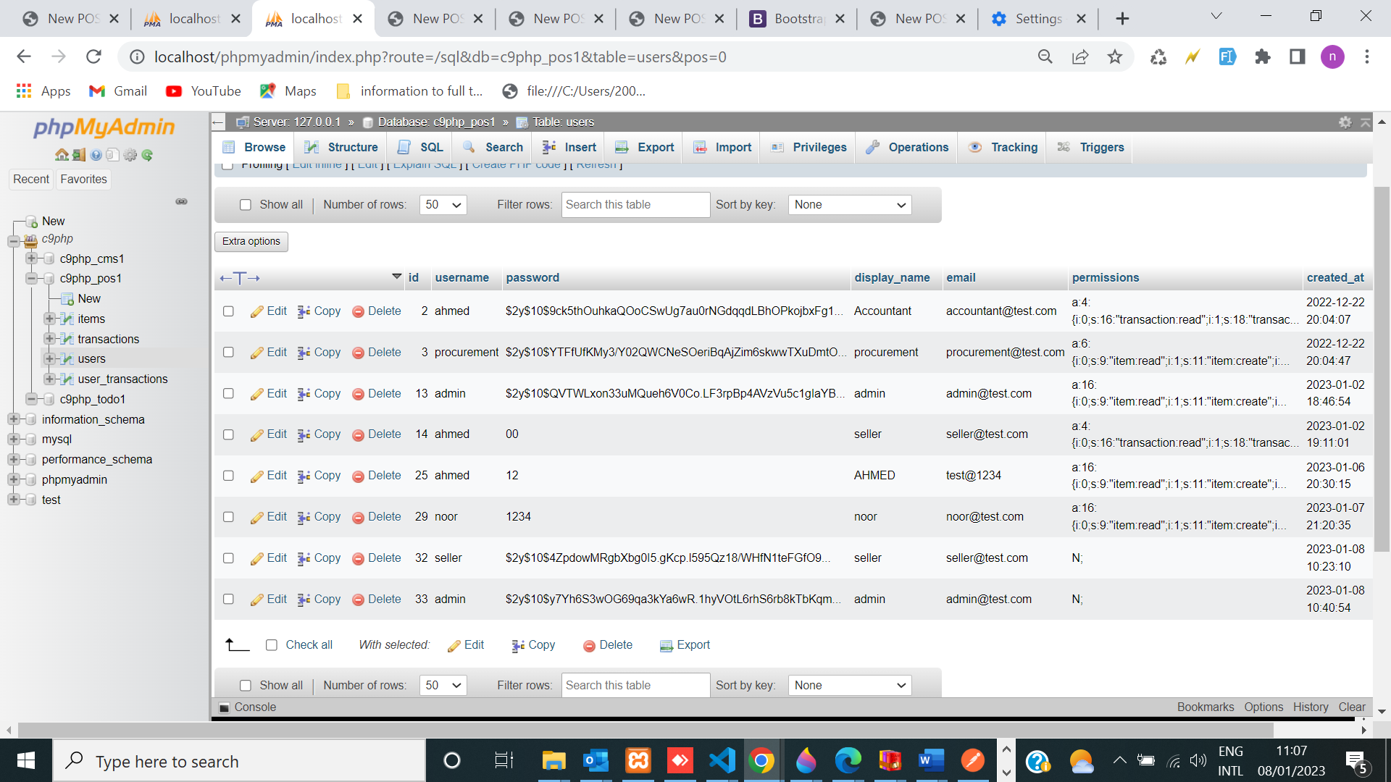
Adding Security by password hash password _default
Notes:
Algorithm use the bcrypt algorithm(default )

Slide 36



HOW WE GET web application should be secured
no easy-to-read passwords
no SQL injection attacks
no XSS vulnerabilities
public function get_by_id($id) {
$stmt = $this->connection->prepare("SELECT * FROM $this->table WHERE id=?");
. $stmt->bind_param('i', $id);
. $stmt->execute();
. $result = $stmt->get_result();
. $stmt->close();
return $result->fetch_object();
}
$_POST['password'] = \password_hash($_POST['password'], \PASSWORD_DEFAULT);
by algorithm default is strong algorithm in php .
Protected function xss (array & $variable) {
}

Slide 37
conclusion
I have realized that (POS) Point Of Sale Web Application is an application that is implemented using MVC design pattern which separates the application data and business logic (model) from the presentation (view) which means that the client layer does not communicate directly with the data layer and It must pass through an intermediate layer.

Slide 38
THANK YOU
NOOR RASHID
noorrashid203@gmail.com
www. .com

